Slide 2
COUNTIES ON FIRE
IS A campaign TO SAVE OUR FORESTS AND COMMUNITIES.
Join EVERGREEN’S GRASSROOTS INITIATIVE TO inform AND ENGAGE THE PUBLIC IN A DIALOGUE ABOUT THE ECONOMIC AND ENVIRONMENTAL COSTS OF THE INCREASING SIZE, DAMAGE, AND OCCURRENCE OF WILDFIRE.

Slide 3
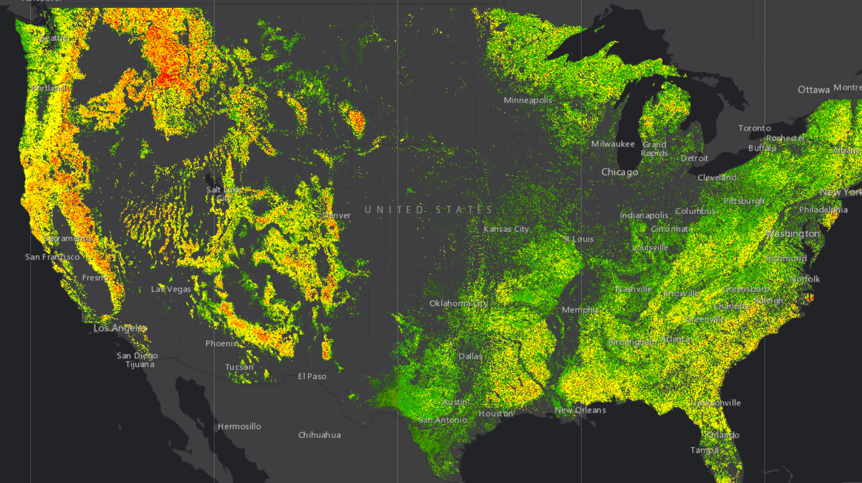
It is time to double down on the promises imbedded in the Forest Service’s latest assessment of the wildfire crisis

Slide 4
“The Forest Service has launched a robust, 10-year strategy to squarely address this wildfire crisis in the places where it poses the most immediate threats to communities. “
“The strategy, called “Confronting the Wildfire Crisis: A Strategy for Protecting Communities and Improving Resilience in America’s Forests,” combines a historic investment of congressional funding with years of scientific research and planning into a national effort that will dramatically increase the scale of forest health treatments over the next decade.”

Slide 5
“Wildfires in the West have been growing in size and severity, placing homes, communities, infrastructure, and natural resources at grave and growing risk.”
“A Bipartisan Infrastructure Law will provide an essential down payment on the resources we need to perform this work. Funds will help accomplish the hazardous fuels and forest heath, ecosystem restoration, community preparedness, and postfire recovery and reforestation work called for in the 10-year strategy and described in this implementation plan. “

Slide 6
Montana's FORESTS ARE BEING DESTROYED BY INSECTS, DISEASE, AND INEVITABLE WILDFIRE.
THIS STORY REPEATS ITSELF ACROSS 11 WESTERN STATES.
Citizens must be empowered to take the steps necessary to create forest-to-community health.

Slide 7
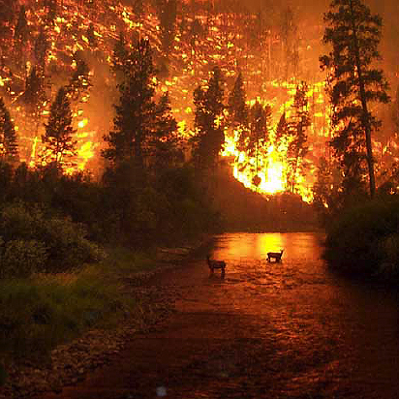
Toward the end of August, the Bitterroot Valley wildfires merged with the Mussigbrod wildfires in the Big Hole River drainage basin to burn more than 247,000 acres. By mid-September 2000, in what has been one of the worst fire seasons in U.S. history, wildfires consumed more than 6,650,000 acres (10,389 square miles) across the country—a total area greater in size than the state of Maryland (9,774 square miles).
Photo - Photo courtesy of John McColgan, Alaska Forest Service

Slide 8
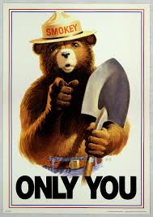
If not YOU,
then who?
If not now,
then when?

Slide 9
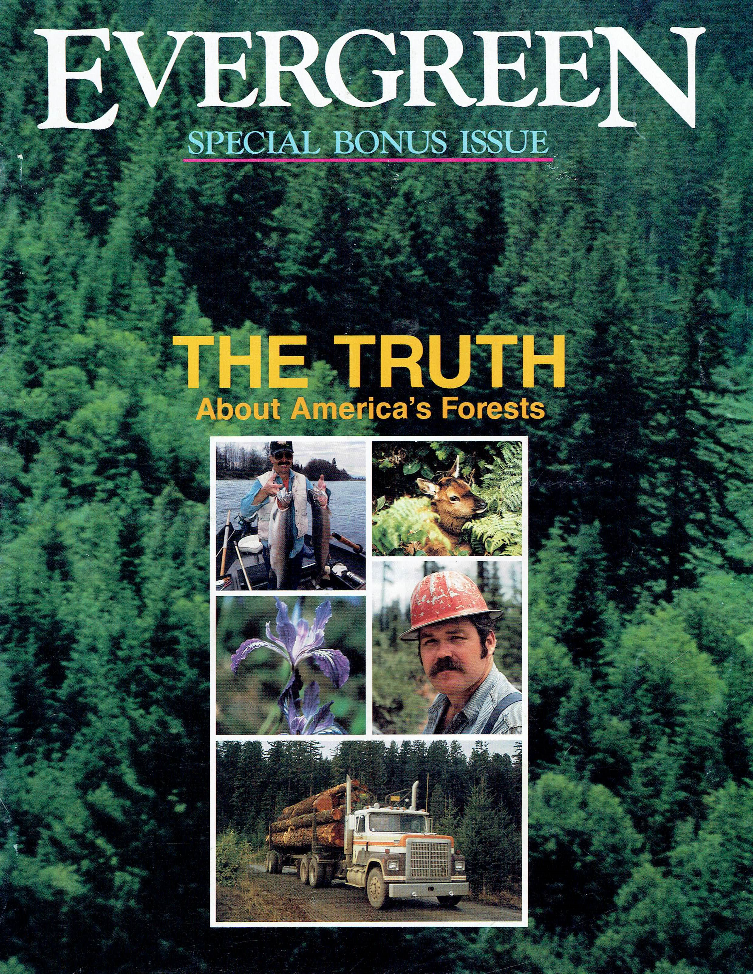
Evergreen focuses on science-based data.
We collect information for public use from a variety of reliable, publicly funded sources. Information is formatted to be easily accessible to a wide demographic - with various levels of understanding of forestry and forest practices.

Slide 10
www.evergreenmagazine.com
EVERGREEN’s mission is to advance public understanding and support for science-based forestry and forest policy.
Evergreen FOUNDATION IS A NON-PROFIT FORESTRY RESEARCH AND EDUCATIONAL ORGANIZATION with over 36 years invested as a leading voice for American forestry.
Evergreen represents the collective resources of over 70 years of work in creating content that addresses the state of our public lands and “Forest-to-community health” - resilient forests that support resilient communities.

Slide 11
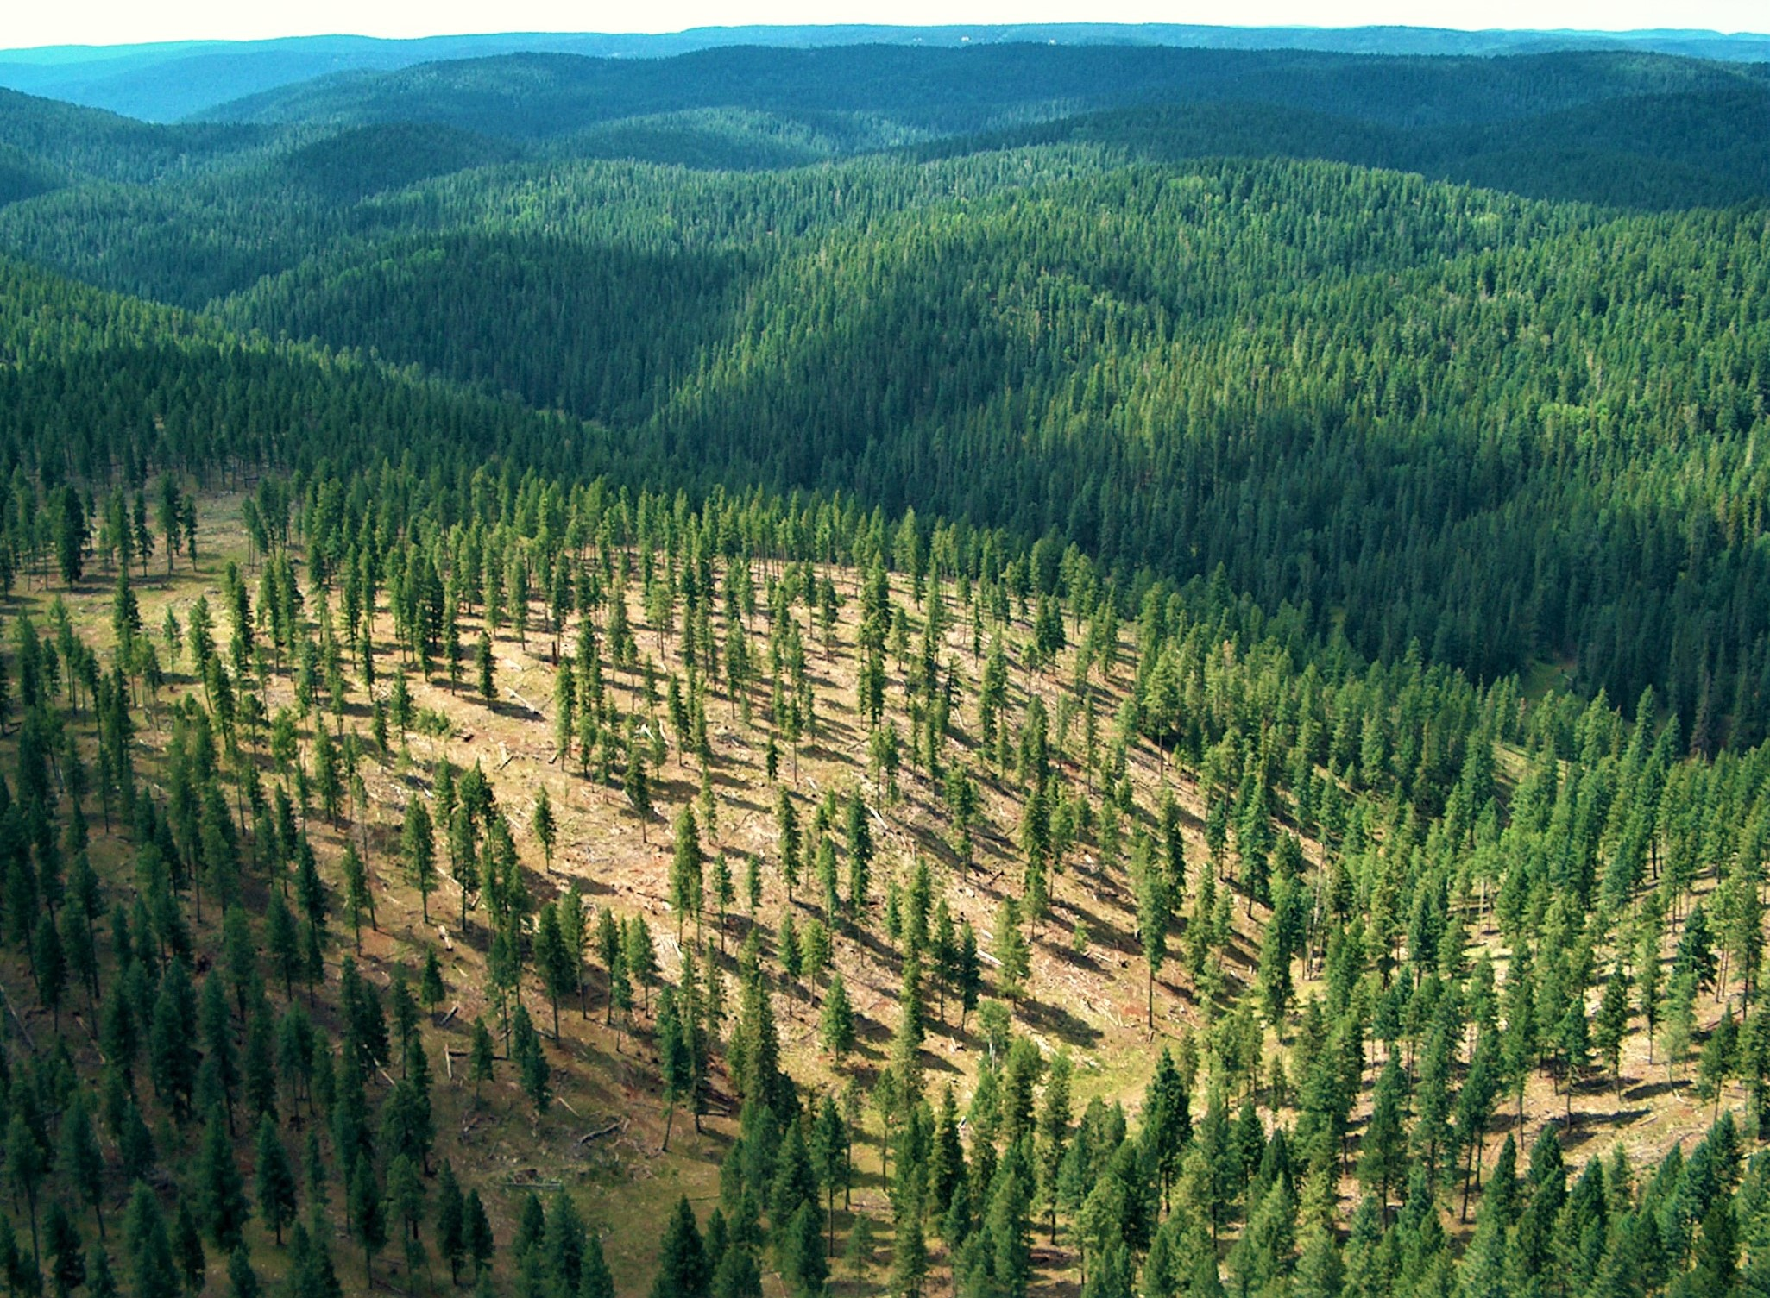
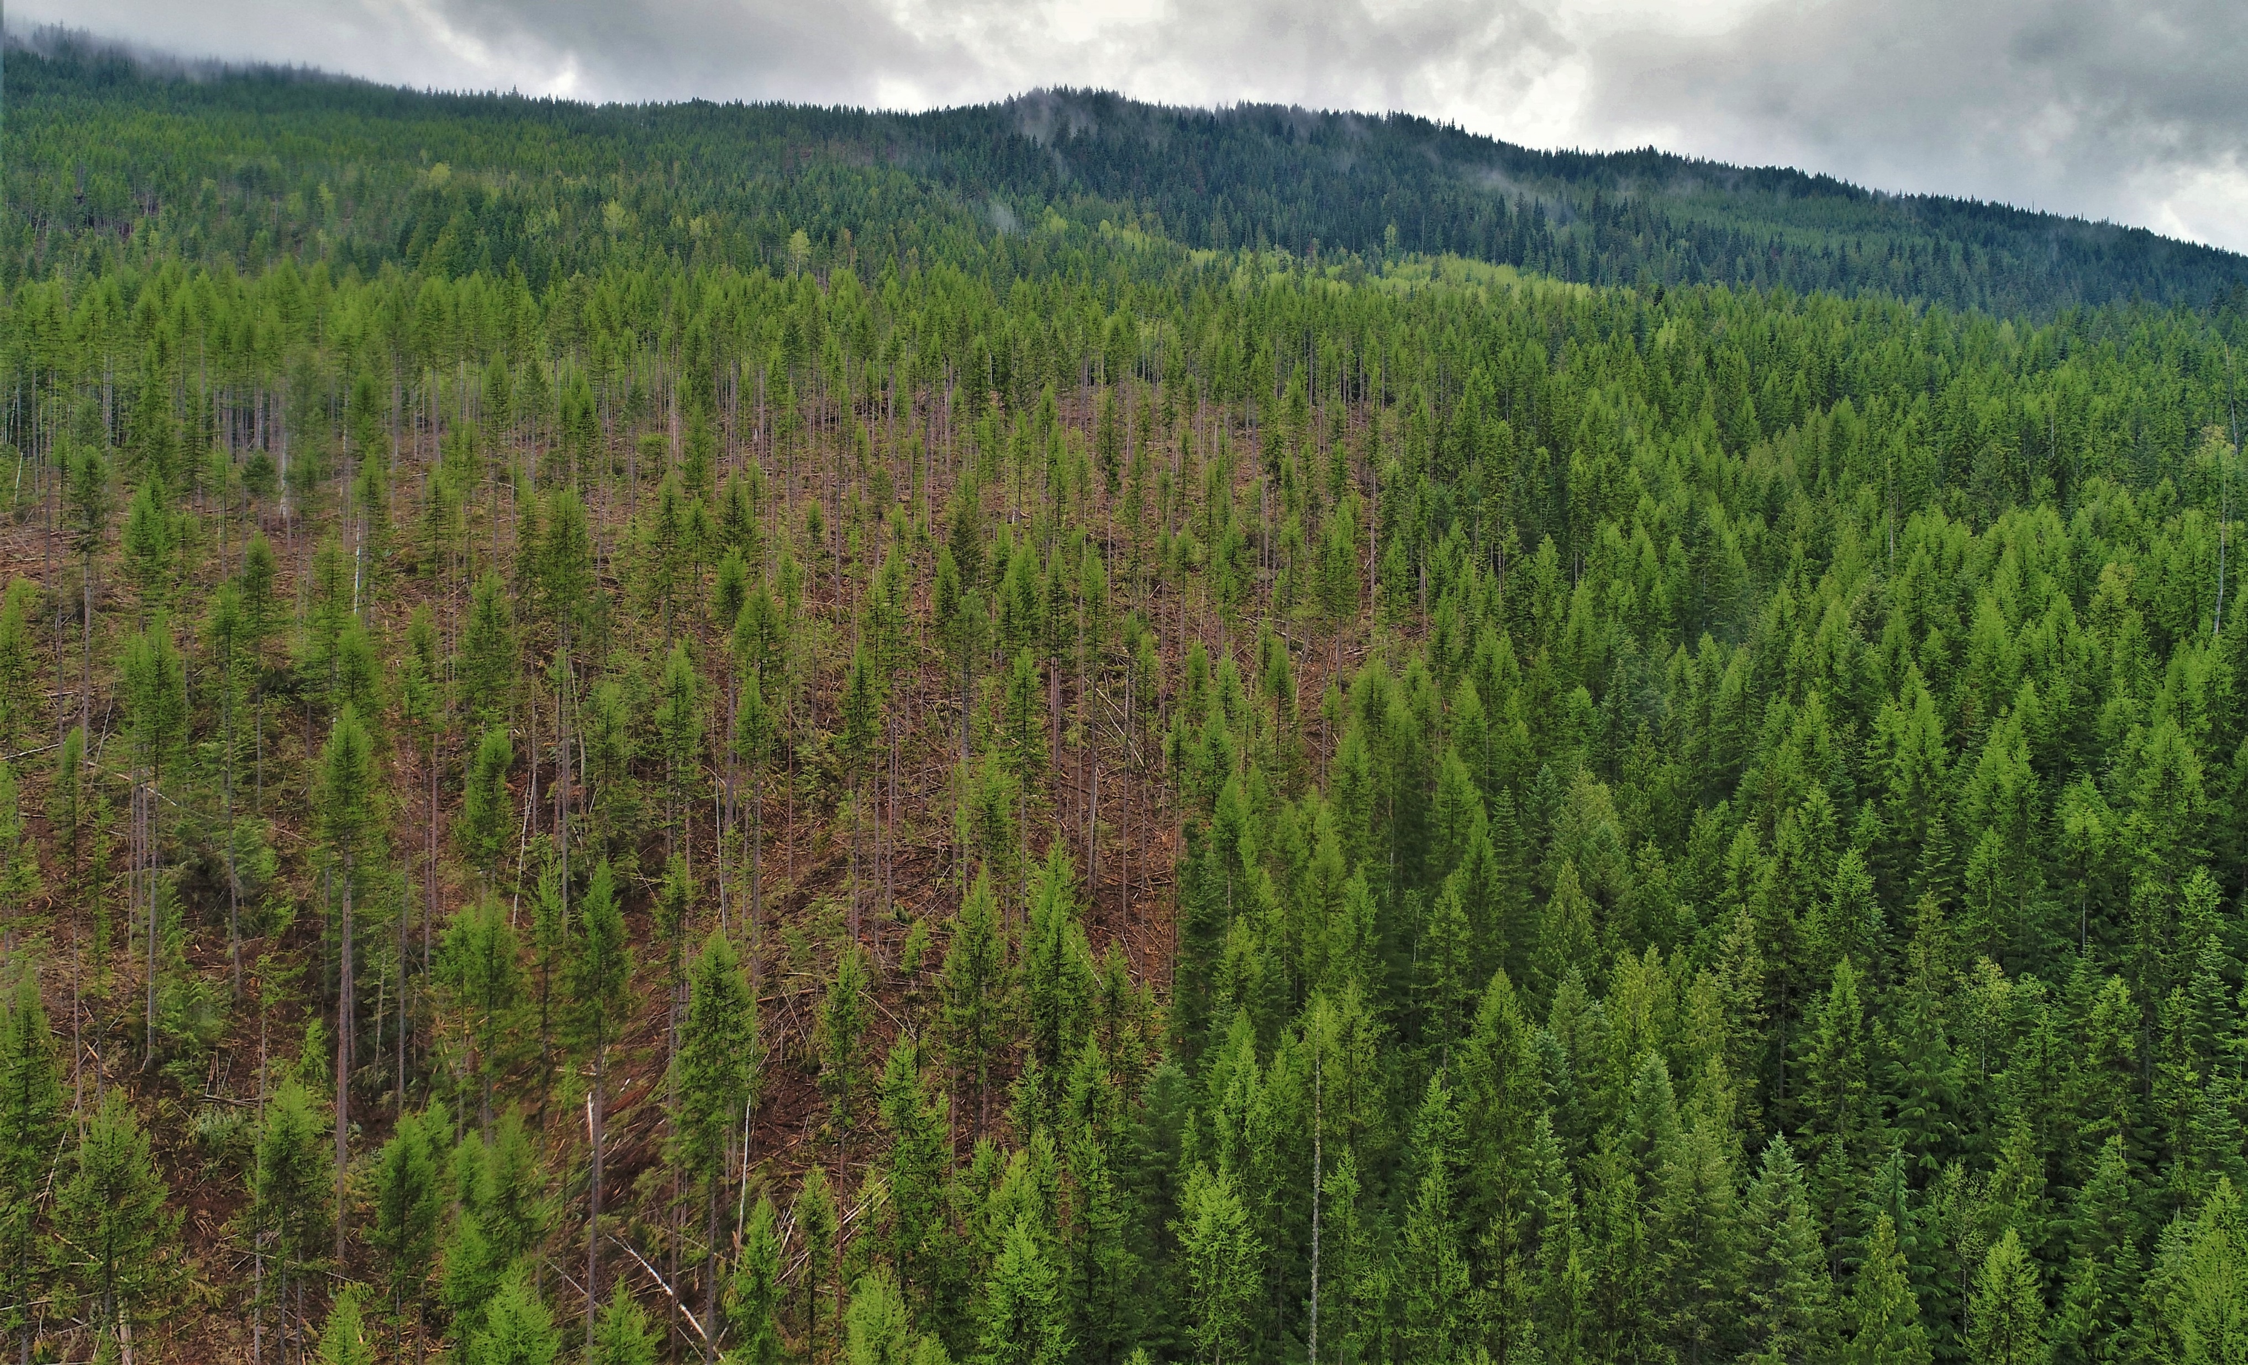
Vaagen Brothers thinning on the Collville National Forest – Northeast Washington
Tribal land management adjacent to Public Lands.

Slide 12
STICKPIN FIRE, 2015

Slide 13
BOOTLEG FIRE, 2021…A PICTURE IS WORTH A THOUSAND WORDS.

Slide 15
Land area in forest (percent)

Slide 17
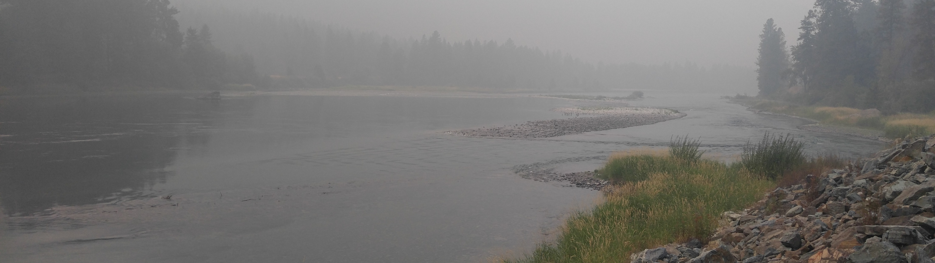
“When we leave forests to nature, as so many people today seem to want to do, we get whatever nature serves up, which can be pretty devastating at times… but with forestry we have options and a degree of predictability not found in nature.”
ALAN HOUSTON

Slide 18
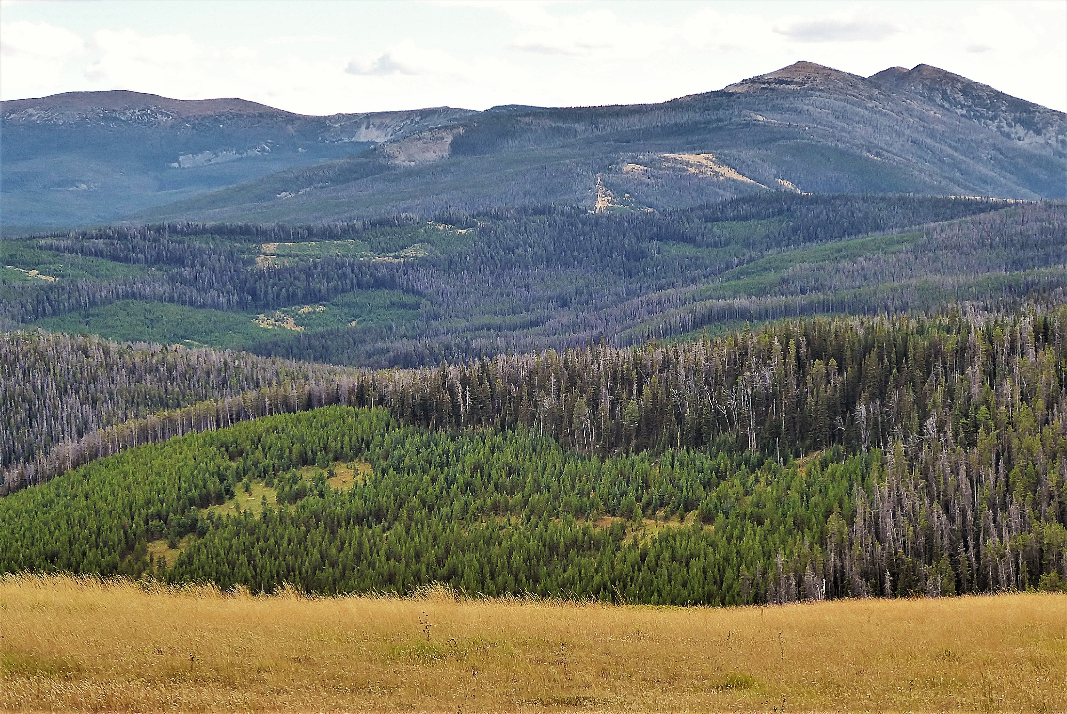
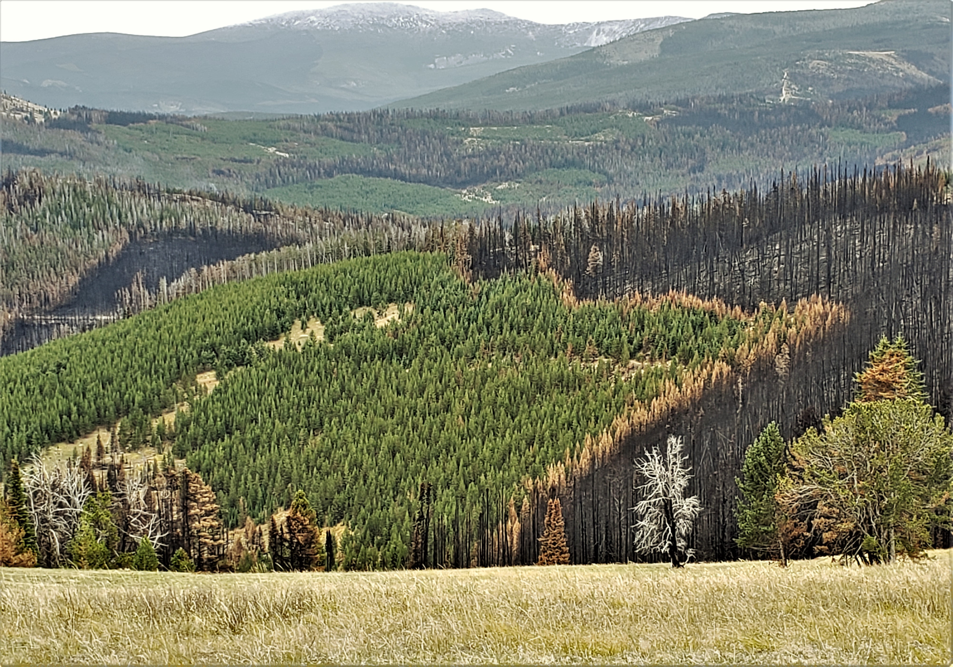
unmanaged/BURNED areas will convert to a mono-culture of brush and lodgepole pine only.
“Along with Thinning,
we must restore forest structural and species diversity - in a mosaic.”
Peter Kolb
The previously managed area retains a full complement of tree species and age diversity.

Slide 19
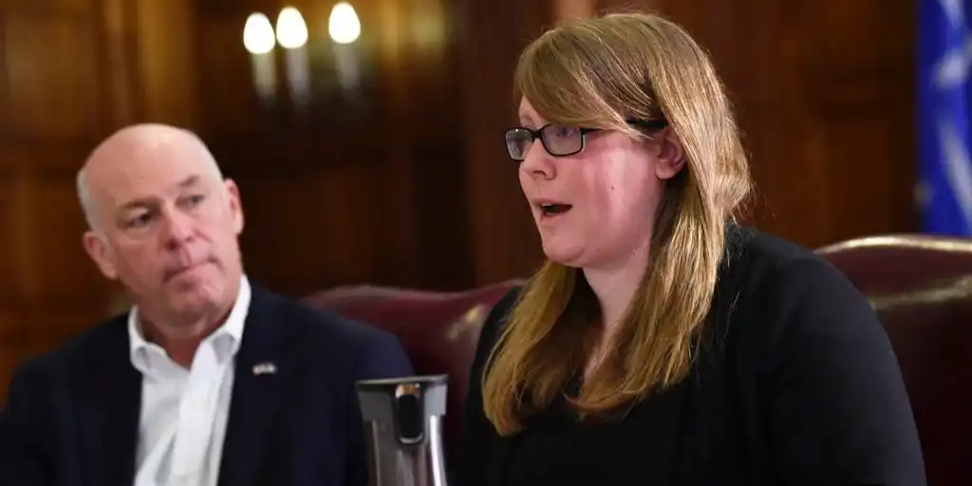
Creating Forest-to-community health requires partnerships at every level

Slide 20
The Kootenai National Forest, is a remote, heavily timbered, 2.2-million-acre expanse. This is a Draft proposal map for the Lincoln county wildland urban interface (Wui) – outlined in Purple. Red and orange identify higher levels of wildfire risk. It is important to note that most of the WUI lies within the Kootenai National Forest. This scenario is common for many rural communities in the west. County commissioners are uniquely positioned to address the wildfire crisis.This is on your watch.

Slide 21
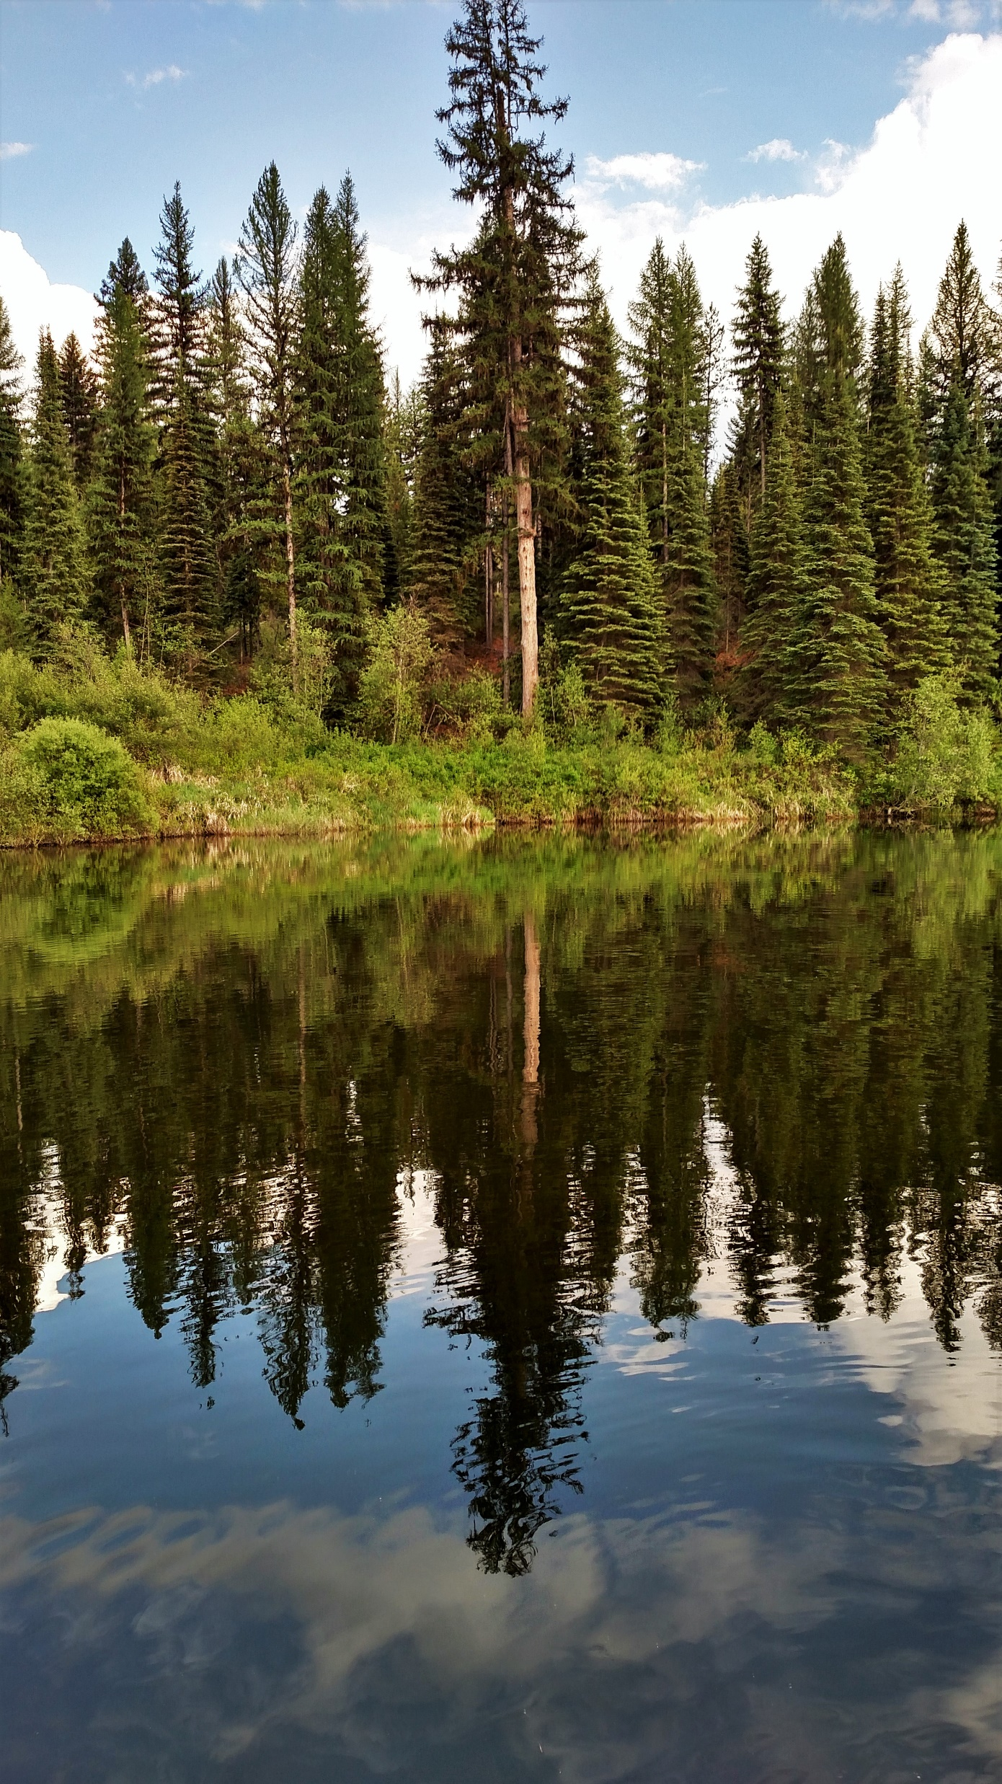
THE YAAK

Slide 22
MANAGING FORESTS WITH A PLAN FOR GRIZZLIES.
CONSERVATION AND FOREST MANAGEMENT CAN BE MUTUALLY INCLUSIVE.

Slide 23
FIA: The Gold Standard delves into the work of The Forest inventory analysis department of the U.s. Forest service. We highlight the 4 main regional research stations within the U.S. - and the specific focus and work within each region, nationally, and globally. Fia data is a staple for evergreen’s science-based message. We encourage you and your community stakeholders to explore and utilize the vast knowledge base FIA has to offer.
Notes:
.

Slide 24
MONTANA’S FORESTS ARE DYING
FASTER THAN THEY ARE GROWING.
THE KOOTENAI NATIONAL FOREST
IS THE ONLY NATIONAL FOREST
WHERE GROWTH EXCEEDS MORTALITY
LOSS CONVERTS TO 2B+ GALLONS OF GAS FOR ALL MT NATIONAL FORESTS
A COMMON DILEMMA IN THE WEST
COMBINED GROWTH AND MORTALITY FOR
THE SEVEN FORESTS IN MONTANA
CAPTURE THE VOLUME BEFORE IT DIES OR BURNS
200M FOR KNF

Slide 25
THE COST OF POLITICS IN NATIONAL FORESTS
COSTS THE KOOTENAI NATIONAL FOREST
363 MILLION BOARD FEET A YEAR.
What ARE POLITICS costing your forestS?

Slide 26
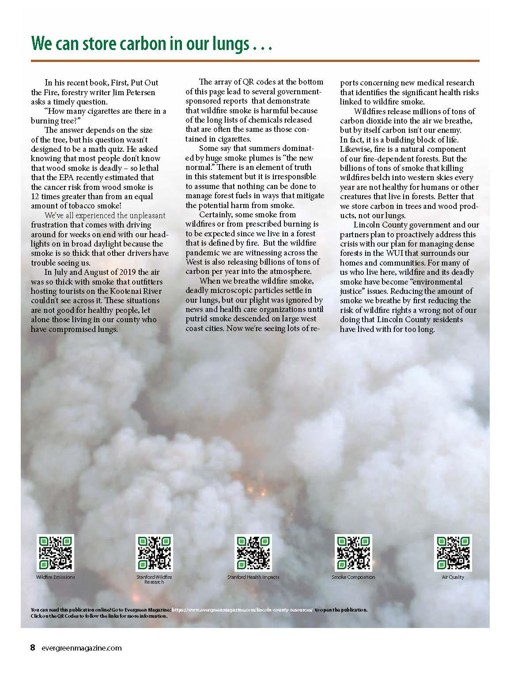
How do you want your smoke?

Slide 27
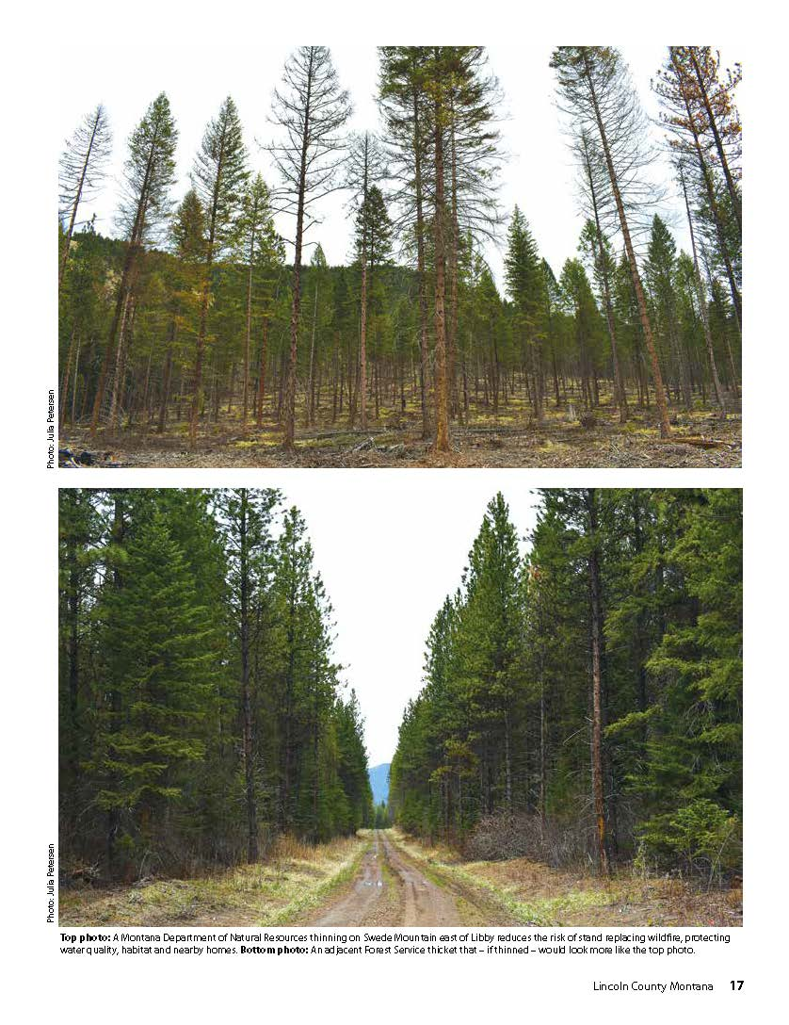
manage for the conditions on the ground Thinning and prescribed fire keep the carbon in the trees

Slide 28
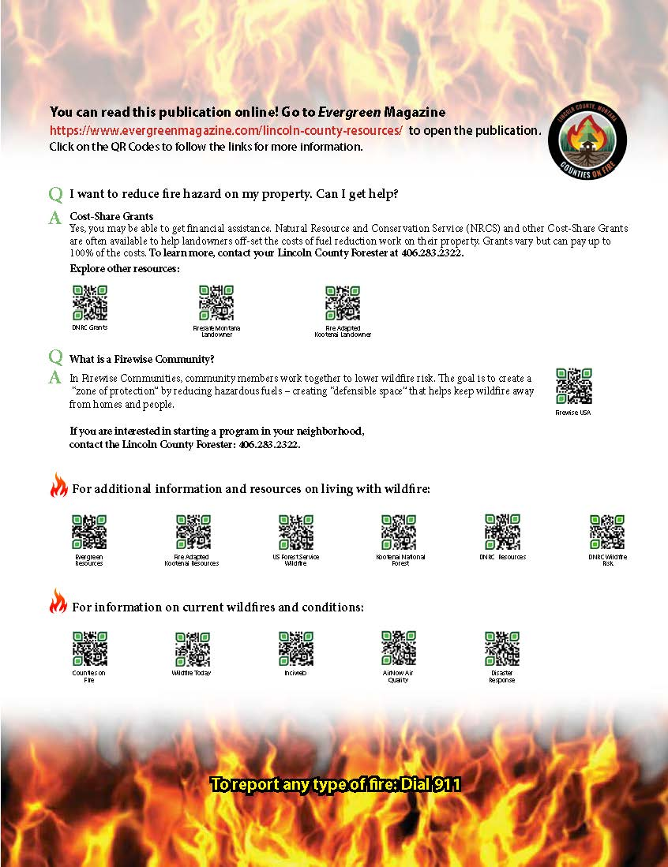
A THIRD OF ALL HOMES IN THE U.S. ARE IN THE wui THOSE WHO LIVE IN THE WUI ARE UNIQUELY POSITIONED AS STEWEARDS RESOURCES AND EDUCATION ARE ESSENTIAL

Slide 29
THIS IS WHAT WE ARE WORKING TO PROTECT!

Slide 30
www.evergreenmagazine.com
jim@evergreenmagazine.com
julia@evergreenmagazine.com
Copyright 1986-2022 Evergreen Magazine All Rights Reserved

